Slide 1

Thinking about quantitative designs
Dr Andi Fugard (they/them)
a.fugard@bbk.ac.uk

Slide 2
This video
Ease into quant thinking
A tour of common quantitative designs
Some issues to ponder

Slide 3
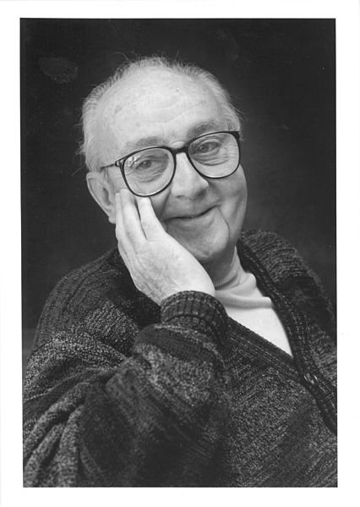
All models are wrong, but some are useful
George E. P. Box (1919 – 2013)

Slide 4
Example research questions – compare/contrast
What do voters in England think about Keir Starmer?
How many nonbinary people are there in England?
Does the support our charity provides help improve service users’ wellbeing?
Does mindfulness prevent depression?
Do people who are introverted read more books?

Slide 5
Question | Measures | Comments
What do voters in England think about Keir Starmer? | % of people who think he’s a good leader? | Particular fixed population Expect views to change? Starmer is specific person
How many nonbinary people are there in the England? | % of adults? | Again a fixed population; expect little change each week
Does the support our charity provides help improve service users’ wellbeing? | Questionnaire scores? | Particular organisation and time. Evaluating an intervention – want change.
Does mindfulness prevent depression? | % of people with depression | Different groups – intervention and control? More general view of population
Do people who are introverted read more books? | Questionnaire score(s) | Trying to understand relationships without intervening.

Slide 6
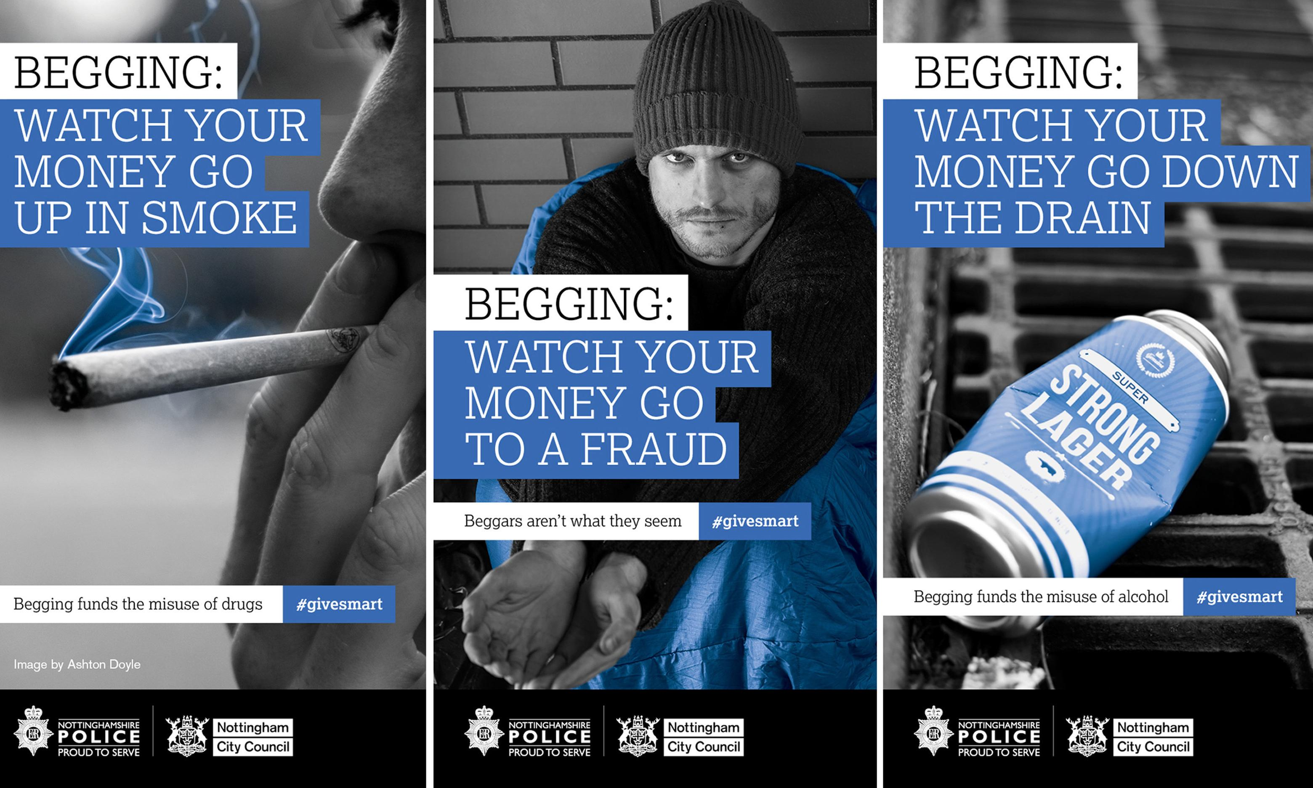
Nottingham City Council campaign, banned by Advertising Standard Authority, Sept 2016

Slide 7
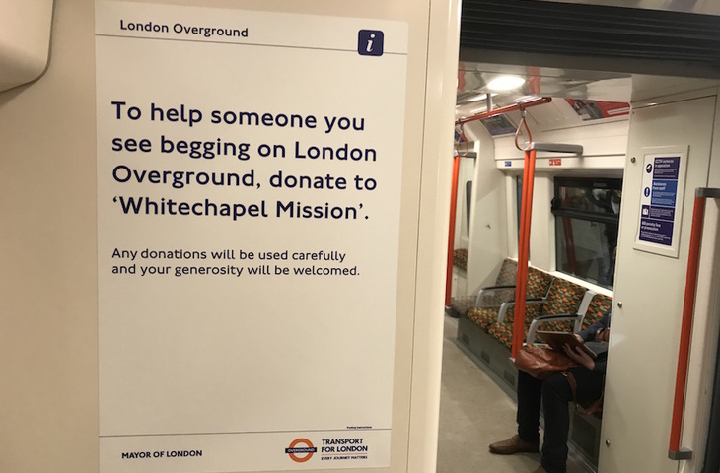
Last seen in 2019 on the Overground…

Slide 8
Pause to think – how might you evaluate whether the ads help/harm?

Slide 9








Advert 1 area
Advert 2 area
No ad area

Slide 10
Advert 1
No ad
Advert 2
Time 1
Time 2

Slide 11
How would you get the data?

Slide 12



















Experiment
Control group
Intervention

Slide 13
Two fab things about randomisation (e.g., Caze, Benjamin, & Senn, 2012)
You don’t need to know all potential confounds – of which there may be hundreds
Confounding factors do not have to be equally balanced between the groups, just randomly distributed

Slide 14
When might randomisation be ethical? (Shadish et al., 2002, p. 269; examples therein)
Demand outstrips supply
Experimental interventions can be varied over time, within participant
A situation needs to be improved but there is no consensus on how
People express no preference for an intervention
A lottery is already expected (tutor assignment, housing block, …)

Slide 15
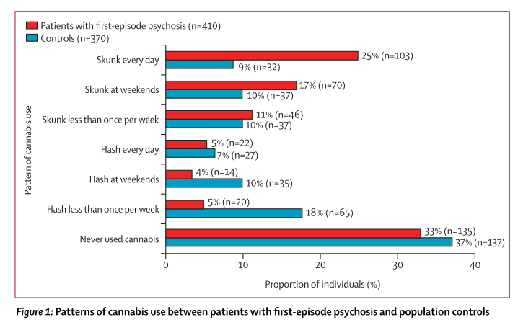
Di Forti et al. (2015). The Lancet Psychiatry, 2, 233–238.

Slide 16
Made Data Experimental | Made Data Observational (e.g. Social Surveys) | Found Data Administrative Data | Found Data Other (e.g., Twitter)
Data collected to investigate a fixed hypothesis Usually relatively small dataset Usually relatively simple structure Highly systematic Known sample / Population | Data may be used to answer multiple research questions Data may be very large and complex Highly systematic Known sample / population | Data were not collected for research purposes May be large and complex May be messy May require linkage Usually known sample / population | Data were not collected for research purposes May be very large and very complex. May be very messy / Involve multiple fragments to connect Sample / population usually unknown
Connelly, R., Playford, C. J., Gayle, V., & Dibben, C. (2016). The role of administrative data in the big data revolution in social science research. Social Science Research, 59, 1–12. doi: 10.1016/j.ssresearch.2016.04.015

Slide 17
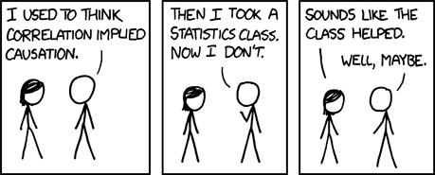
“Correlation does not imply causation”
Arrrrrgggggghhhhhhh
https://xkcd.com/552/

Slide 18
Something more useful
‘… the slogan “correlation does not imply causation” can be translated into a useful principle: one cannot substantiate causal claims from associations alone, even at the population level—behind every causal conclusion there must lie some causal assumption that is not testable in observational studies.’
Pearl, J. (2009). Causal inference in statistics: An overview. Statistics Surveys, 3, 96–146.

Slide 19
Take intermediate quantitative research
More competent at quant methods

Slide 20
Need for intellectual challenge
Take intermediate quantitative research
Read stats books
Play around with R for fun
More competent at quant methods

Slide 21

Need for intellectual challenge
Take intermediate quantitative research
Read stats books
Play around with R for fun
More competent at quant methods

Slide 22
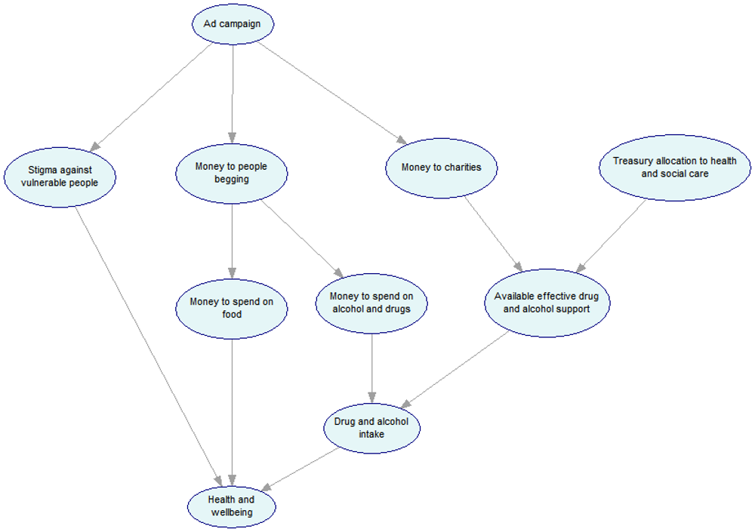
Fugard, A. (2016, Oct 6). Can we really say that giving money to people begging makes their problems worse? The Conversation.

Slide 23

Design element: comparison groups
None / single / multiple conditions
Cohorts, e.g., quants class one year to next
Between group
Within group (change condition over time)

Slide 24

Assignment to conditions
Random allocation
Assign based on some criteria
Match groups on something you know
Issue of whether or not you mask/“blind” assignment, e.g., to people making observations

Slide 25
Measurement
When?
pre-post / post an intervention?
What?
multiple outcome measures (benefits/harms)
measuring threats to validity (confounders)
standardised measures or develop new ones
open/closed answers (tick boxes?)
Whose views?
self-report
researcher

Slide 26
Noughts and crosses (Campbell, 1957… Shadish, Cook, & Campbell, 2002)
Intervention
O | X | O
Observation
O | X | O
O |  | O
Rows are conditions
Non-random assignment
NR | O | X | O
NR | O |  | O

Slide 27


Further reading

Slide 28

Summary
There’s a HUGE number of different flavours of design
Often ethical and resource constraints on what studies we can run
The method of data collection and assumptions we are willing to make constrain what the stats can tell us
There’s a wealth of design ideas in the literature – go search!
a.fugard@bbk.ac.uk

